Slide 1
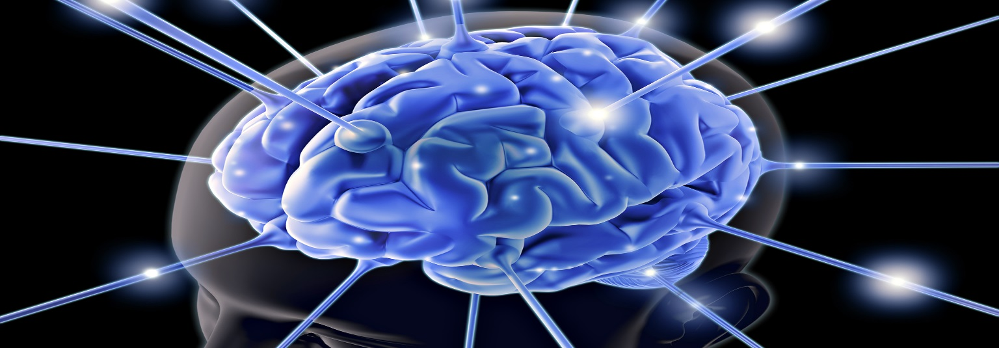
Neuroscience
Foundation Group
Do you want to get involved in neuroscience and cognition chiropractic research? The Neuroscience Foundation Group may be for you! The Dr. Sid E. Williams Center for Chiropractic Research is looking for students to become engaged and assist with the Chiropractic Neuroscience Research at Life University.
User Groups will be established in
Cognition
Evoked Potential
qEEG
Student Commitment
1 hour a week for team meeting
(excluding midterm and final weeks)
1-3 hours weekly study including equipment operation and journal article review
For more information,
please contact Dr. Stephanie Sullivan
at Stephanie.Sullivan@life.edu

